Slide 1
Descriptive Data Mining
Cluster analysis using K-Means
By Yamini Pathuri, Koundinya Raghava Nerella
Instructor: Aparna Varde
CSIT - 558: Data Mining
Montclair State University, NJ

Slide 2
About Dataset:
The Data is taken from MovieLens and has 25 million ratings and one million tag applications applied to 62,000 movies by 162,000 users
.We aim to analyze how ratings of the genres compare to each other.
We are considering ‘Action’ and “Comedy’ genres from the dataset to compare the average movie rating and cluster them using K-Means.
We also aim to find the ideal number of clusters for the effective clustering with ideal intra cluster and inter clustering distances.

Slide 3
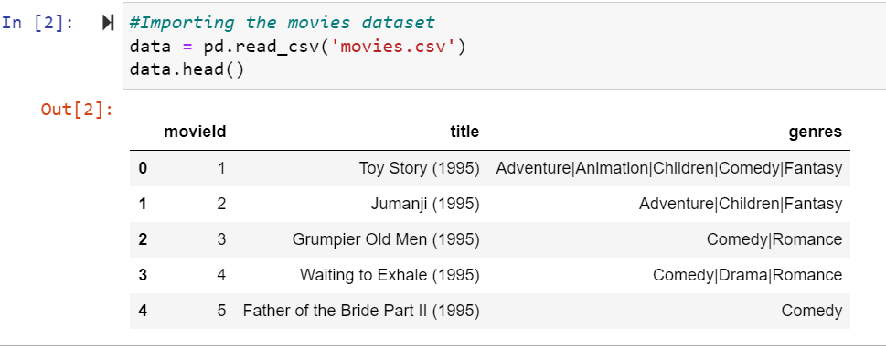
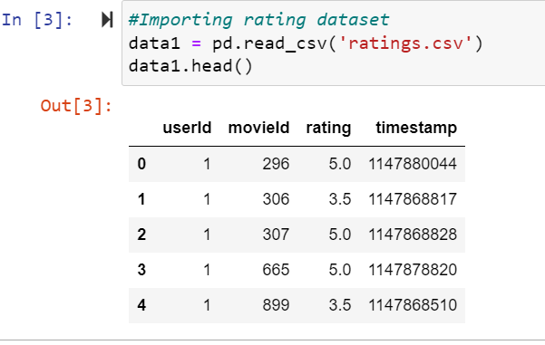
Loading Movie and Ratings Dataset

Slide 4
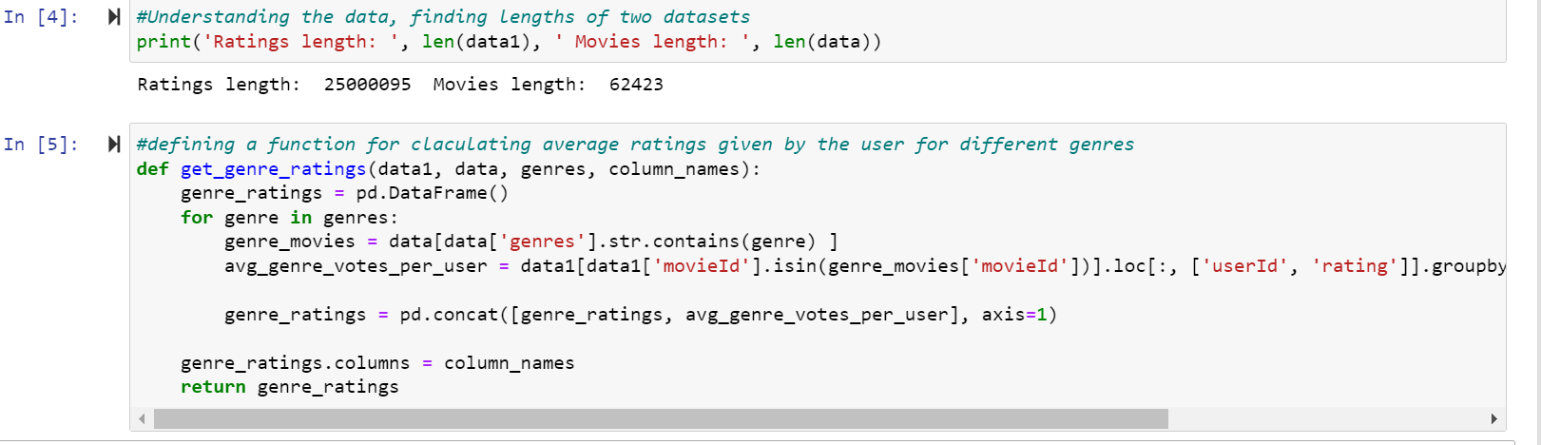
Calculating average ratings for genres ‘action’ and ‘comedy’

Slide 5
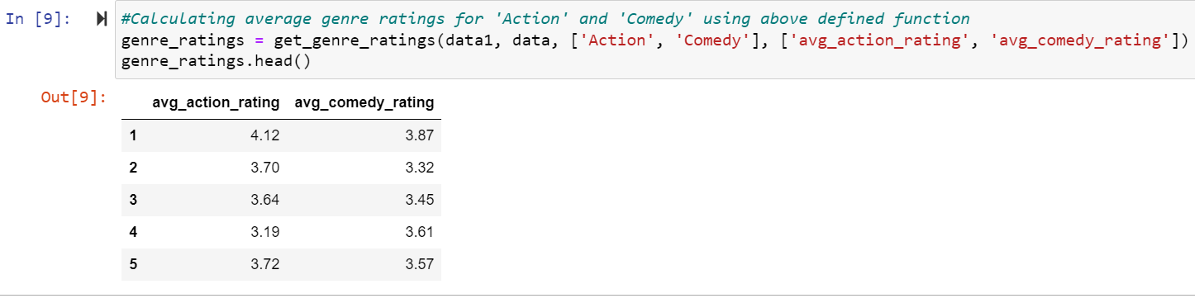
Calculating average user ratings for ‘action’ and ‘comedy’ genres

Slide 6
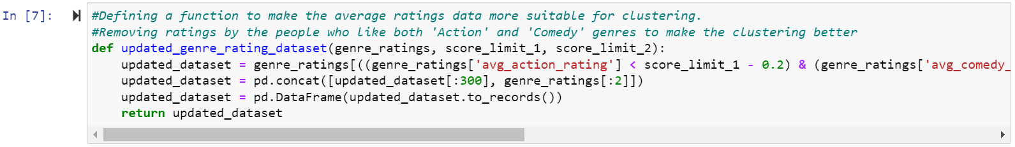
Excluding people who like both genres:

Slide 7
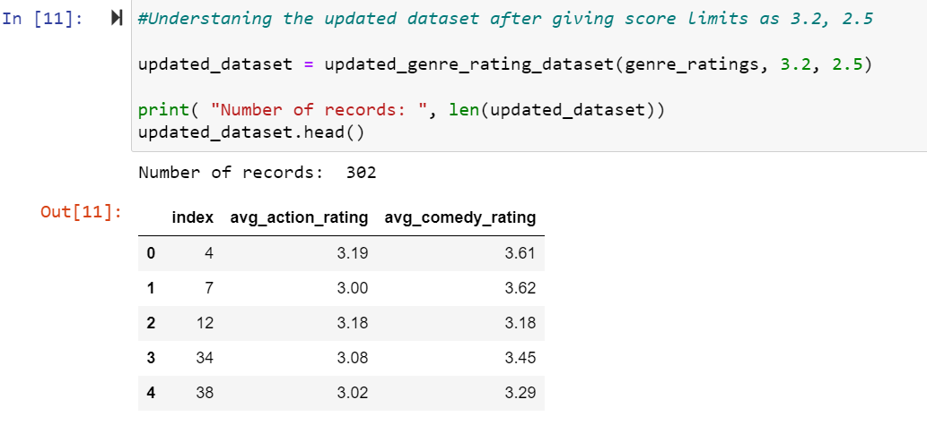
Excluding people who like both genres:

Slide 8
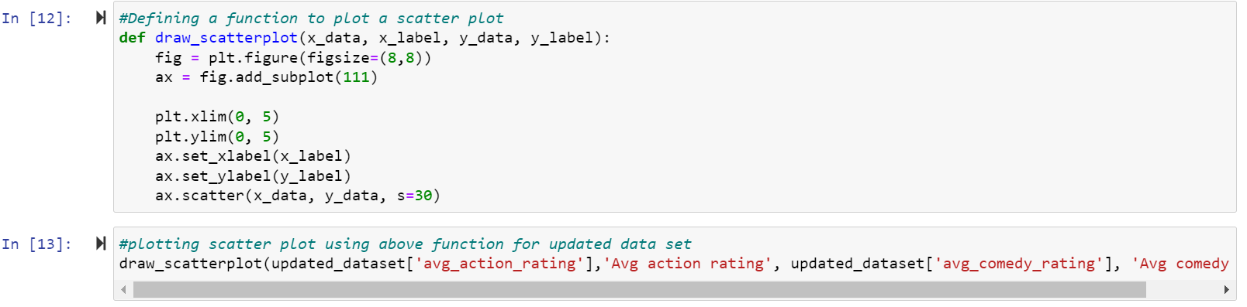
Applying scatter plot:

Slide 9
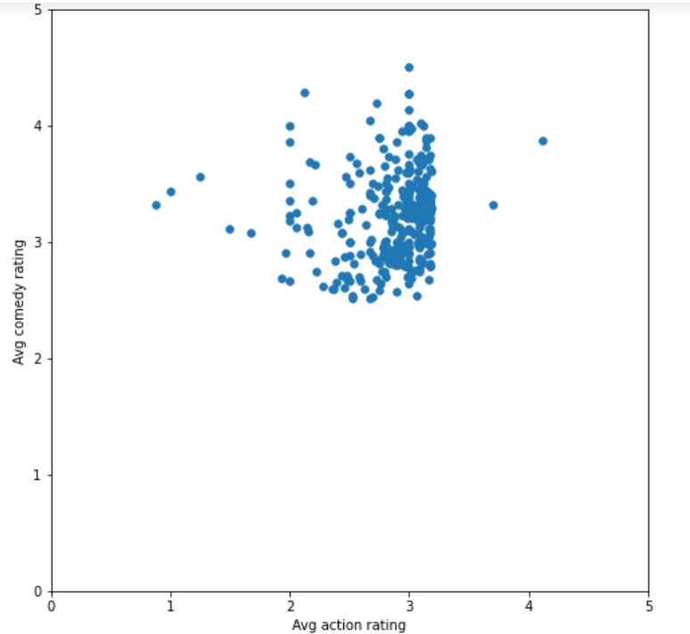
Scatter Plot

Slide 10
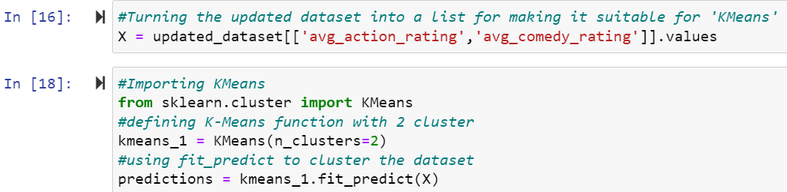
Applying KMeans

Slide 11
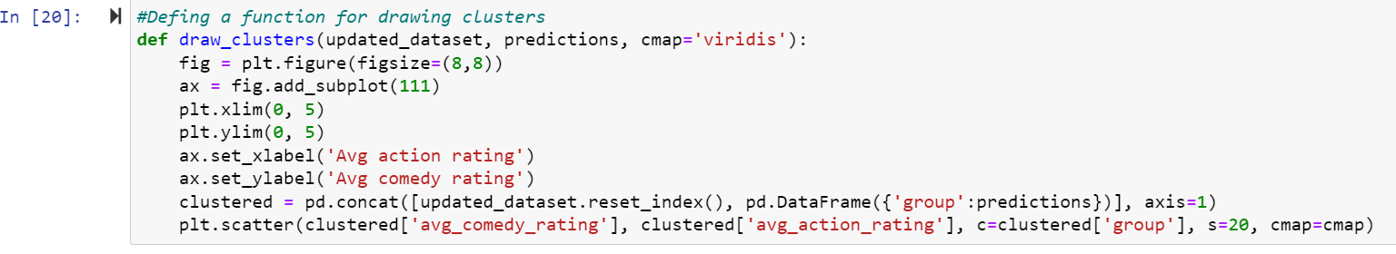
Defining a function for drawing clusters

Slide 12
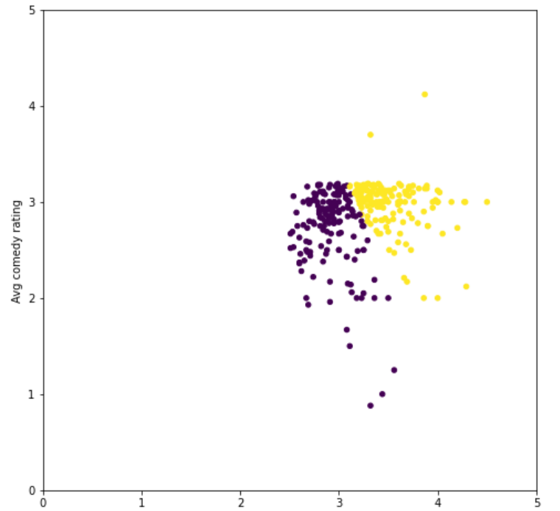
Clustering with 2 clusters:
The average rating of ‘action’ genre is roughly clustered as less than 3.5 and greater than 3.5

Slide 13
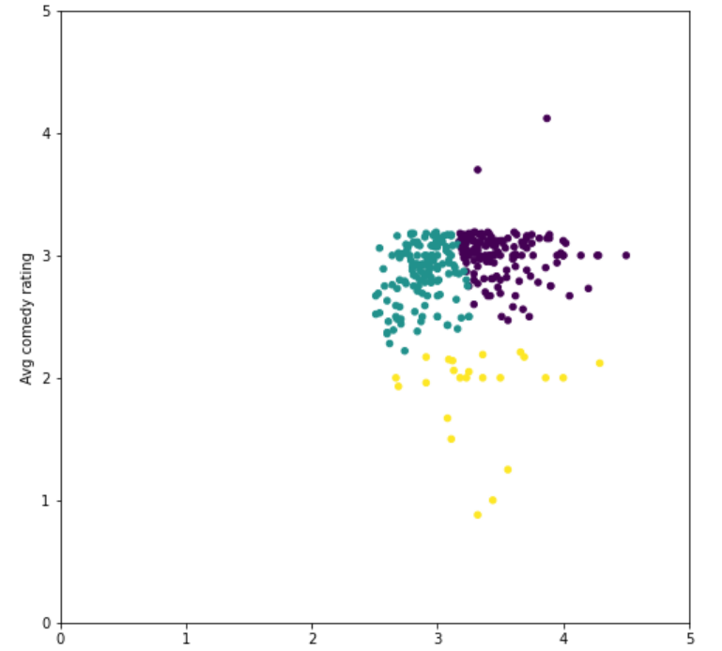
Clustering with 3 clusters
Cluster 1: Avg comedy rating > 2 and Avg action rating <3
Cluster 2: Avg comedy rating < 3 and and avg action rating >3.
Cluster 3: Avg comedy rating < 2 and Avg action rating >2.5

Slide 14
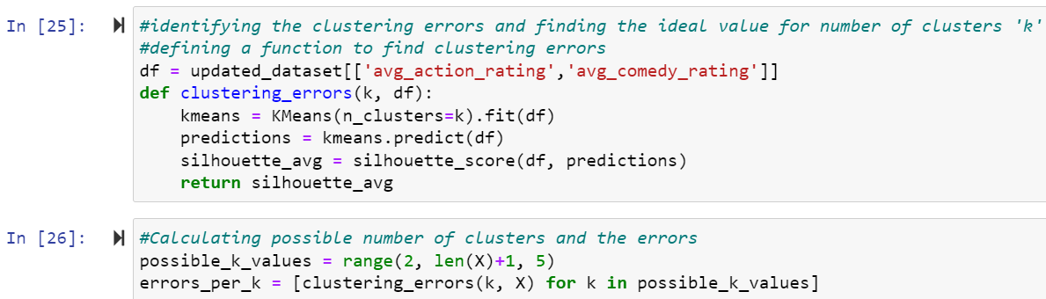
identifying the clustering errors and finding the ideal value for number of clusters 'k'

Slide 15
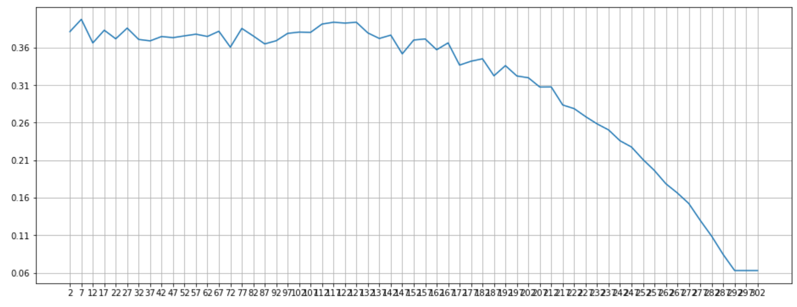
Possible values of K plotting with respective silhouette score:

Slide 16
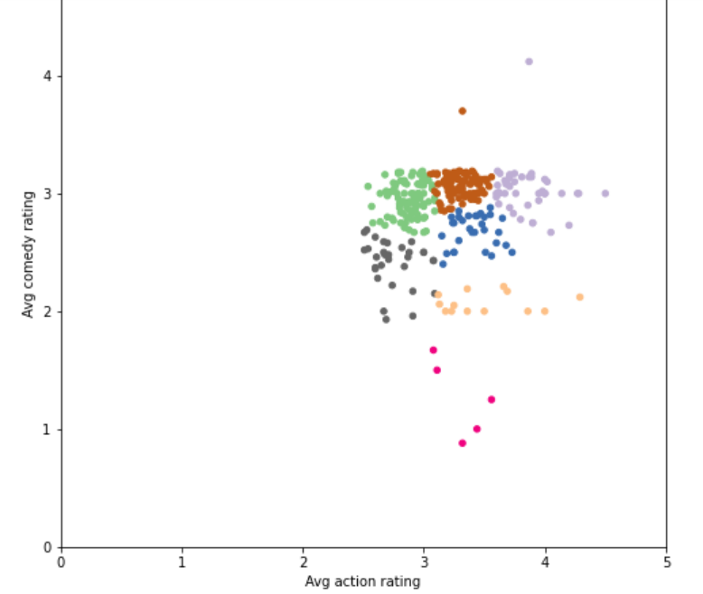
Clustering with 7 clusters as per the results in above plot:
Both avg ratings < 3
Both avg ratings = 3
Avg action rating > 3.5 & avg comedy rating < 3
Avg comedy rating < 3 & avg action rating >3
Avg comedy rating >2 & avg action rating <3
Avg comedy rating = 2
7. Avg comedy rating < 2 and Avg action rating >3

Slide 17
Conclusion
As per the clustering, the clusters are formed more towards the bottom right of the plot, which indicates that ‘comedy’ genre movies are rated less score frequently when compared to ‘action’ genre movies. Which concludes that the impressing audience with ‘action’ genre is easier when compared to ‘comedy’ genre.

Slide 18
References:
MovieLens | GroupLens
https://www.analyticsvidhya.com/blog/2016/11/an-introduction-to-clustering-and-different-methods-of-clustering/
Rate and connections limits (pandascore.co)
Python Scatter Plot - Python Geeks
K-Means Clustering in Python: Step-by-Step Example - Statology
Silhouette Coefficient. This is my first medium story, so… | by Ashutosh Bhardwaj | Towards Data Science

